Slide 1

COURT BOOKING PROJECT
CSE4001-Cloud Computing
Project Presentation
Slot: D1+TD1
Team-1A
Submitted to: Dr. Rohit Kumar Das

Slide 2
Team Members:
Team: 1A
Name | Reg No
Tamanampudi Naveen Sai | 19BCD7003
Bussa Sai Bipin | 19BCD7025
P Sai Rajesh Varma | 19BCD7044
V S S Abhinav Teja | 19BCD7073

Slide 3
Index:
S. No | TOPIC | PAGE NO.
1. | Introduction | 4
2. | Different pages in the web application | 5
3. | Services Used | 6
4. | Creating Instances of RDS and EC2 | 7-18
5. | Connecting to EC2 Instance | 19-24
6. | Connecting and Managing Databases | 25-28
7. | Copying files to EC2 Instance | 29-34
8. | Amazon Route 53 | 35-39
9. | Checking the Website | 40-50
10. | Demonstration Video Links | 51
11. | Conclusion | 52

Slide 4
Introduction:
In a given ground, there will be many different courts for different sports.
In this project, we have assumed that the ground contains 2 Volleyball Court, 2 Cricket Pitches, 2 Shuttle/Badminton Courts, 2 Tennis Courts and 1 Football stadium.
The aim of this project is to digitalize the booking of the court with the help of a web application hosted using Amazon Web Services (AWS).
User can register and login to the web application and can book a court based on availability.

Slide 5
Different pages in this web application:
Intro.html – The index page.
Page1.html – Contains login form.
Register.php – Contains registration form.
Ground.html – Ground Layout.
Loginvalidation.php - validates the user and redirect to page2.php if the user credentials are correct.
Page2.php – Displays all the courts with booking and check availability options
B1.php,B2.php,C1.php,C2.php,F1.php,T1.php,T2.php,V1.php,V2.php displays current bookings for Badminton, Cricket, Football, Tennis, Volleyball respectively.
Book.php – for booking a court.

Slide 6
Services Used:
Amazon Elastic Compute Cloud(EC2): It is a part of Amazon.com's cloud-computing platform, Amazon Web Services, that allows users to rent virtual computers on which to run their own computer applications.
Amazon Relational Database Service(RDS):It is a distributed relational database service by Amazon Web Services. It is a web service running in the cloud designed to simplify the setup, operation, and scaling of a relational database for use in applications.
Amazon Route 53: It is a scalable and highly available Domain Name System service.

Slide 7
Configuration, Connectivity and Security of Created DB instance in RDS – cloud:
Name of Database: cloud
Endpoint: cloud.c7sovmb4ucbm.ap-south-1.rds.amazonaws.com
Port: 3306
Publicly Accessible: Yes
VPC Security Group: CC_Project (sg-052ddb52a590a71c2)

Slide 8
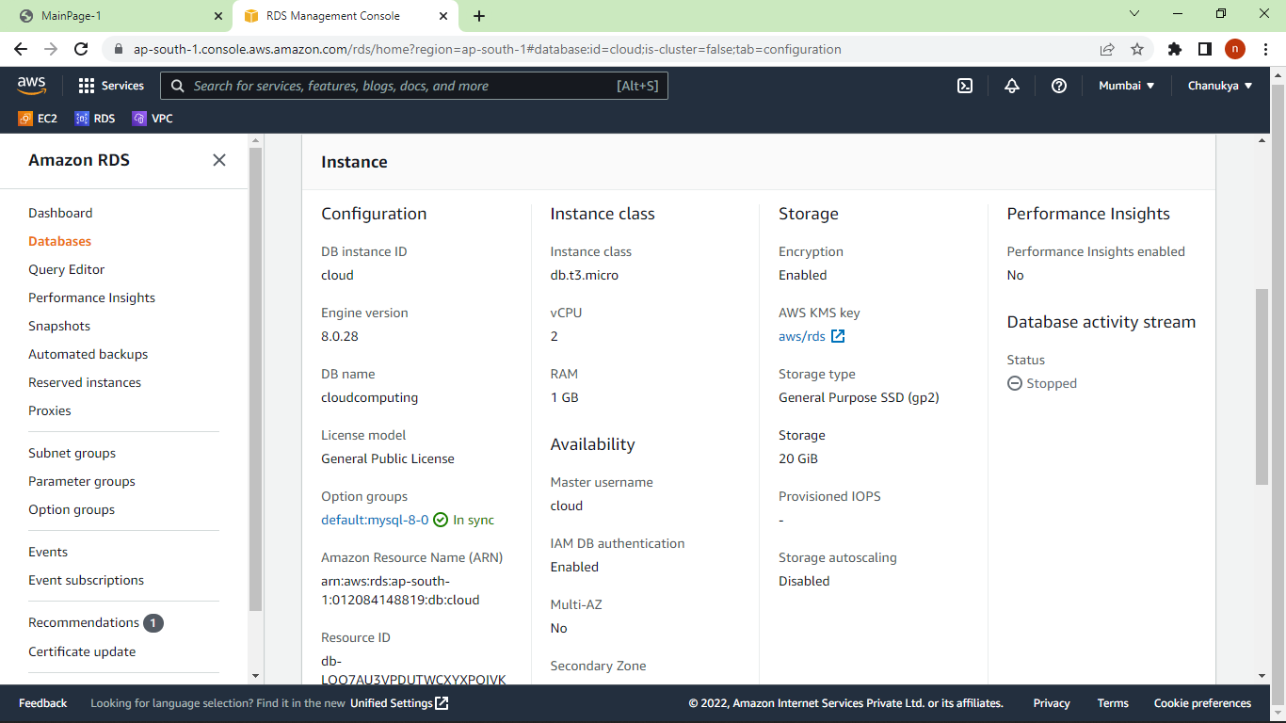

Slide 9
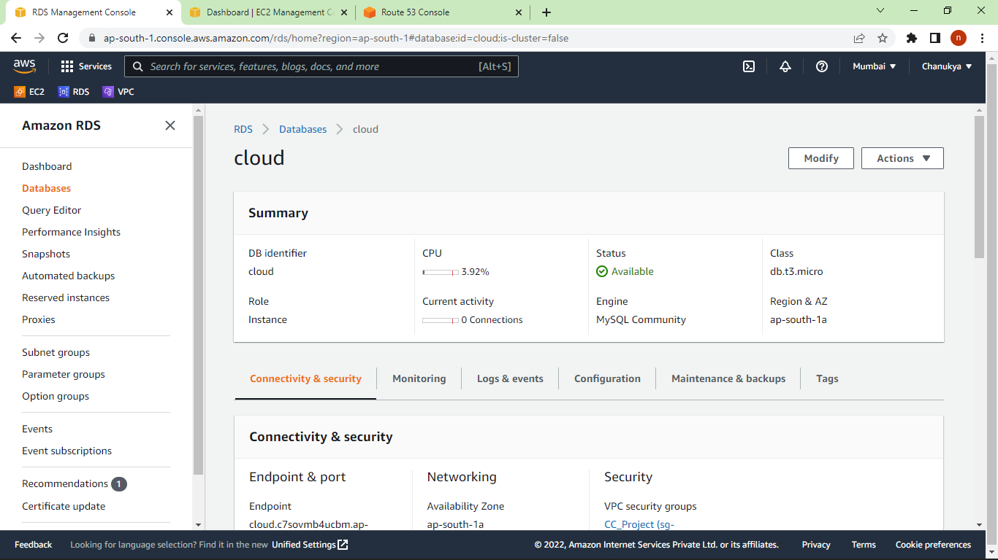

Slide 10
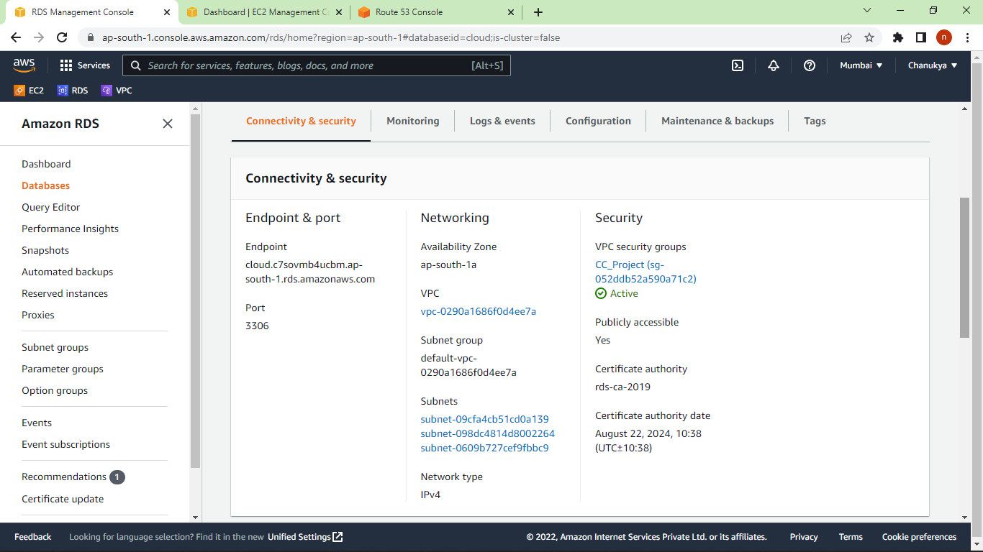

Slide 11
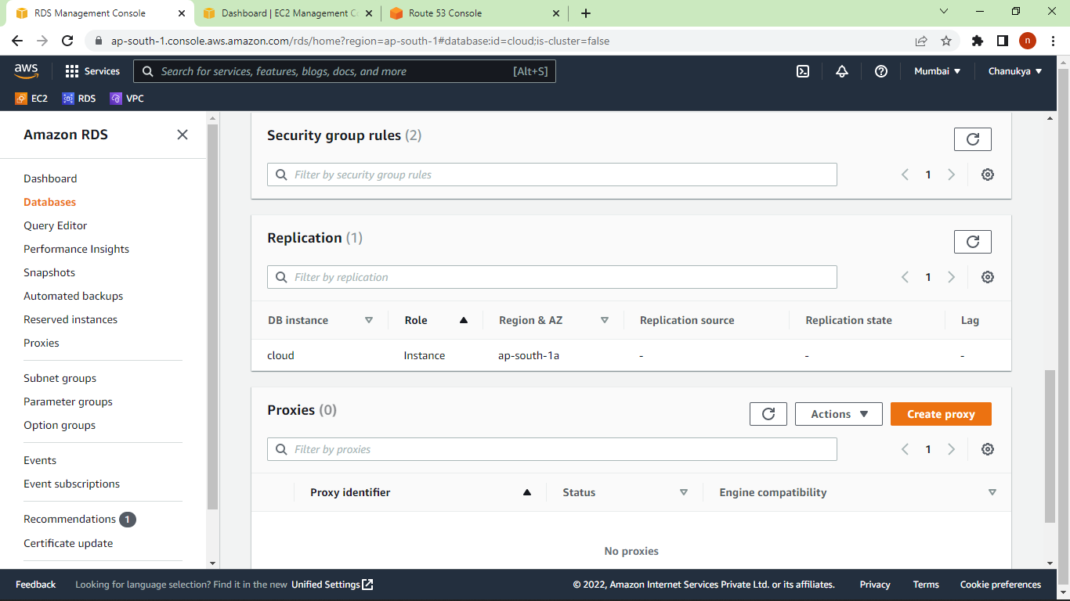

Slide 12
Details of the EC2 Instance- team1a
Name of the EC2 instance – team1a
Public IPv4 Address: 3.7.73.160
Public IPv4 DNS: ec2-3-7-73-160.ap-south-1.compute.amazonaws.com
Platform: Ubuntu
Version: 20.04 LTS
Key Pair Name: team1a

Slide 13
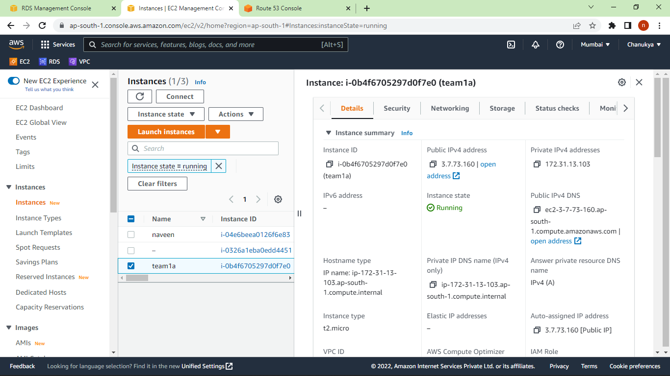

Slide 14
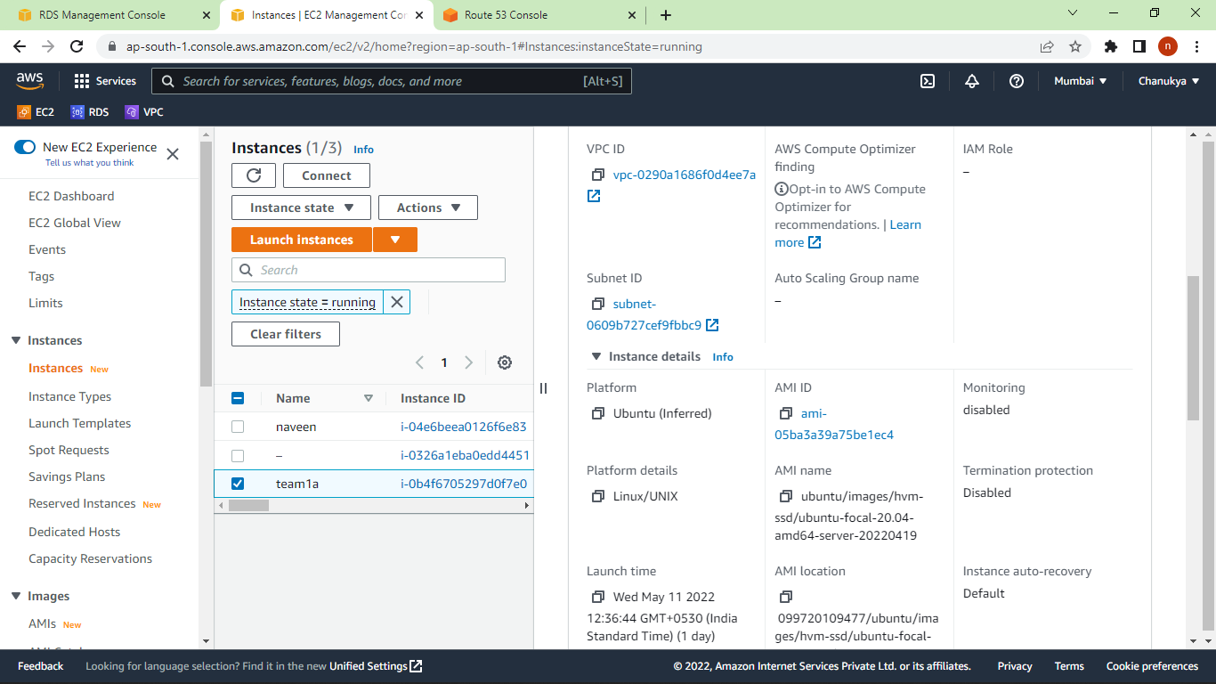

Slide 15
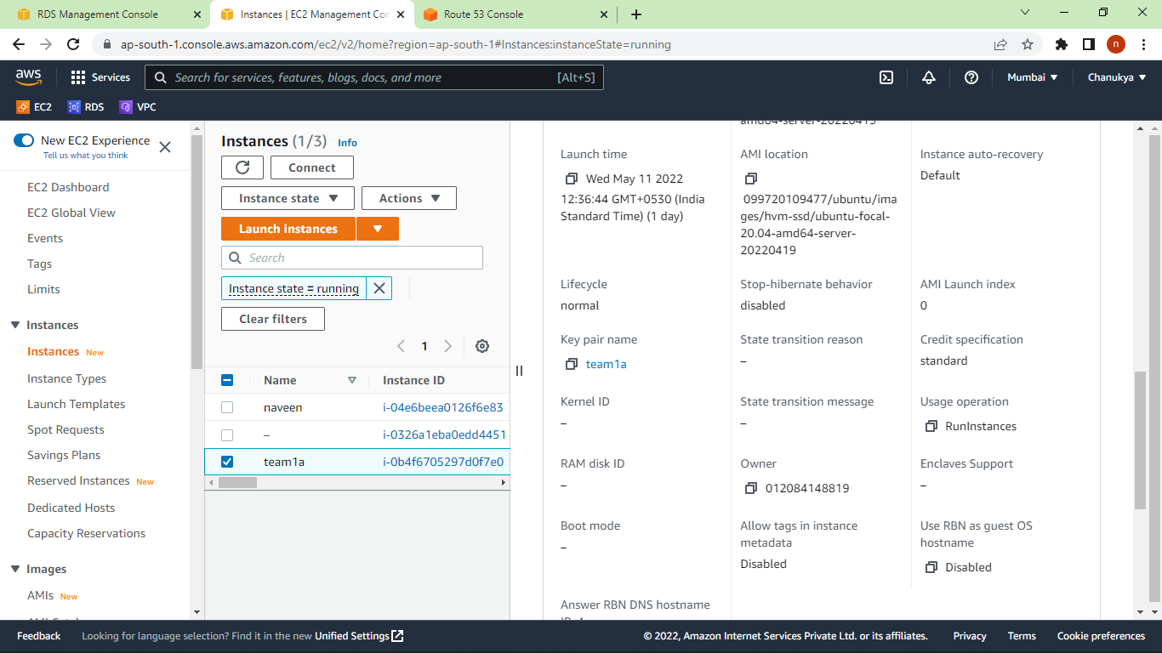

Slide 16
VPC Security Group of RDS:
A security group is like a virtual firewall. It works much like a traditional firewall does. It consists of a set of rules that can be used to monitor and filter an instance's incoming and outgoing traffic in a Virtual Private Cloud (VPC) instance.
Security Group Name: CC_Project
No of Inbound Rules: 1
No of Outbound Rules: 1

Slide 17
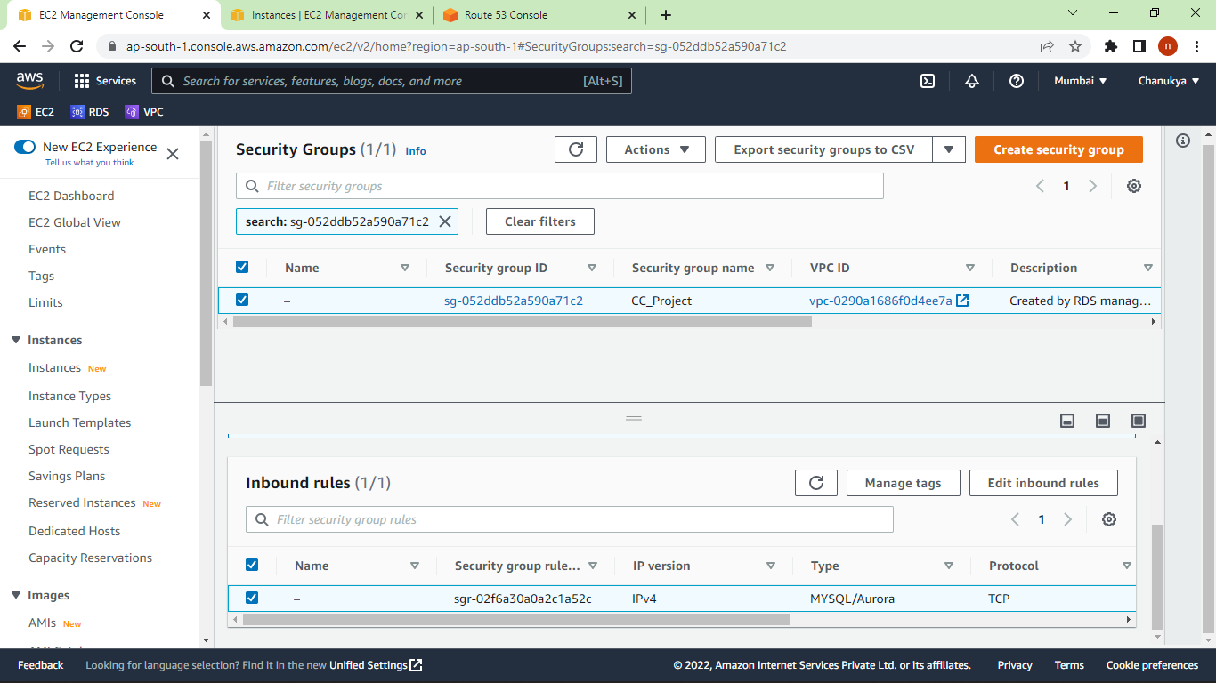

Slide 18
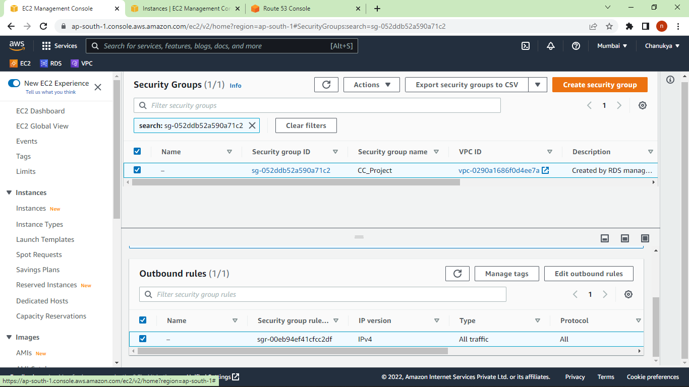

Slide 19
Generating Public and Private Keys:
Now, we need to generate public and private keys from the key pair created during the creation of EC2 instance.
PuTTYgen can be used for this purpose.
PuTTYgen is an key generator tool for creating SSH keys for PuTTY. It is analogous to the ssh-keygen tool used in some other SSH implementations. The basic function is to create public and private key pairs.
Key Pair: team1a
Public Key: public
Private Key: private.ppk

Slide 20
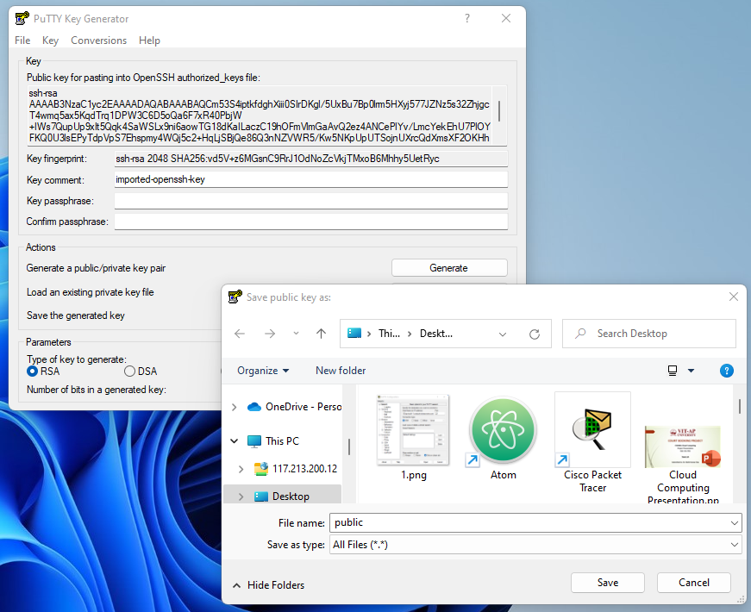
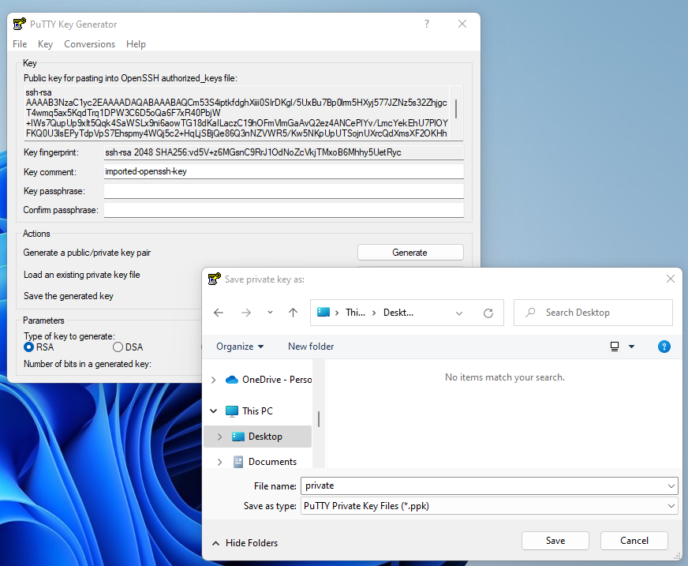

Slide 21
SSH to EC2 instance:
We can connect to our ec2 instance using PuTTY.
PuTTY is a free and open-source terminal emulator, serial console and network file transfer application. It supports several network protocols, including SCP, SSH, Telnet, rlogin, and raw socket connection. It can also connect to a serial port.
Hostname: ec2-3-7-73-160.ap-south-1.compute.amazonaws.com
Key: private.key

Slide 22
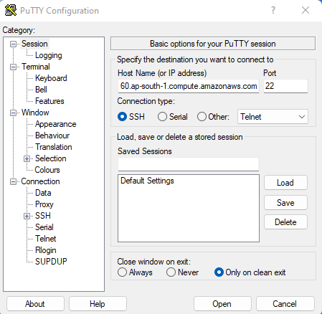
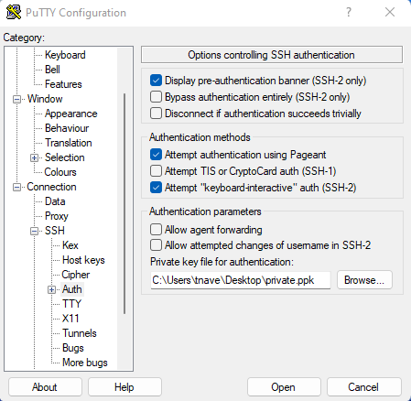

Slide 23
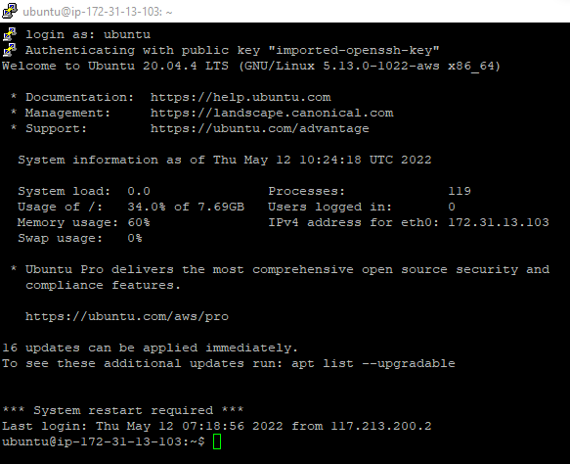

Slide 24
Now, we need to install few things in our EC2 instance.
1. Download package information from all configured sources
Command: sudo apt-get update
2. Install Apache2
Command: sudo apt-get install apache2
3. PHP and related stuff installation
Command: sudo apt-get install php libapache2-mod-php php-mysql php-curl php-gd php-json php-zip php-mbstring
4. Install MySQL
Command: sudo apt-get install mysql-server

Slide 25
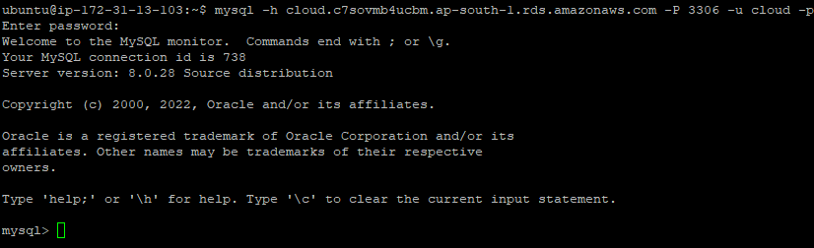
Connect and Manage Databases with command line SSH:
Command: mysql -h cloud.c7sovmb4ucbm.ap-south-1.rds.amazonaws.com -P 3306 -u cloud –p

Slide 26
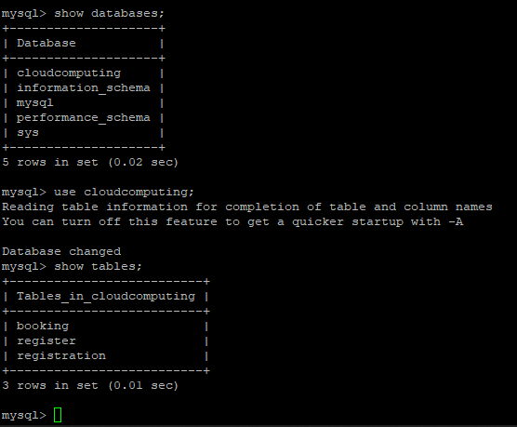
Checking the Available Database and tables:

Slide 27
Table Creation:
We have created the tables – booking and register using the following MySQL queries.
create table booking(courtno varchar(4) primary key, username varchar(20), name varchar(20), fromtime varchar(10), totime varchar(10), date varchar(10));
create table register(username varchar(20) primary key, name varchar(20), emailid varchar(30), phoneno varchar(10), password varchar(8));

Slide 28
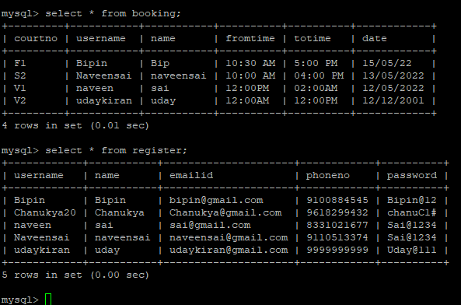
Content of the Tables:

Slide 29
Copying files from Local Device to EC2 instance:
We are having all the php files, html files and images in our local device. We need to move those to our EC2 instance.
We can use WinSCP to achieve this.
WinSCP is a free and open-source SSH File Transfer Protocol, File Transfer Protocol, WebDAV, Amazon S3, and secure copy protocol client for Microsoft Windows. Its main function is secure file transfer between a local computer and a remote server.
Hostname: ec2-3-7-73-160.ap-south-1.compute.amazonaws.com
Username: Ubuntu
Password: Advanced -> SSH -> Authentication -> Upload private.ppk

Slide 30
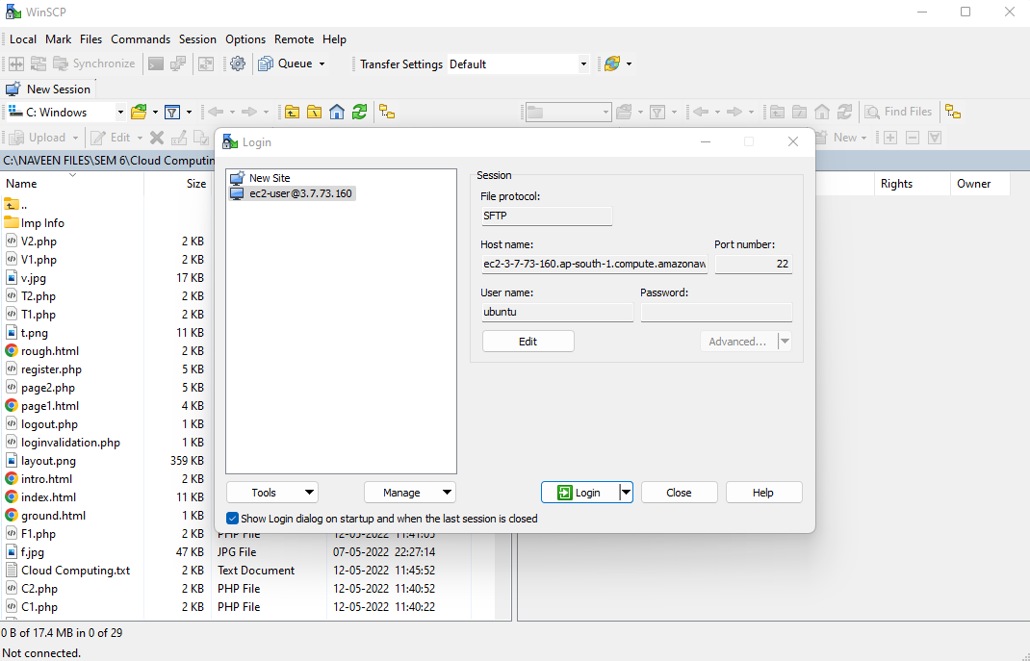

Slide 31
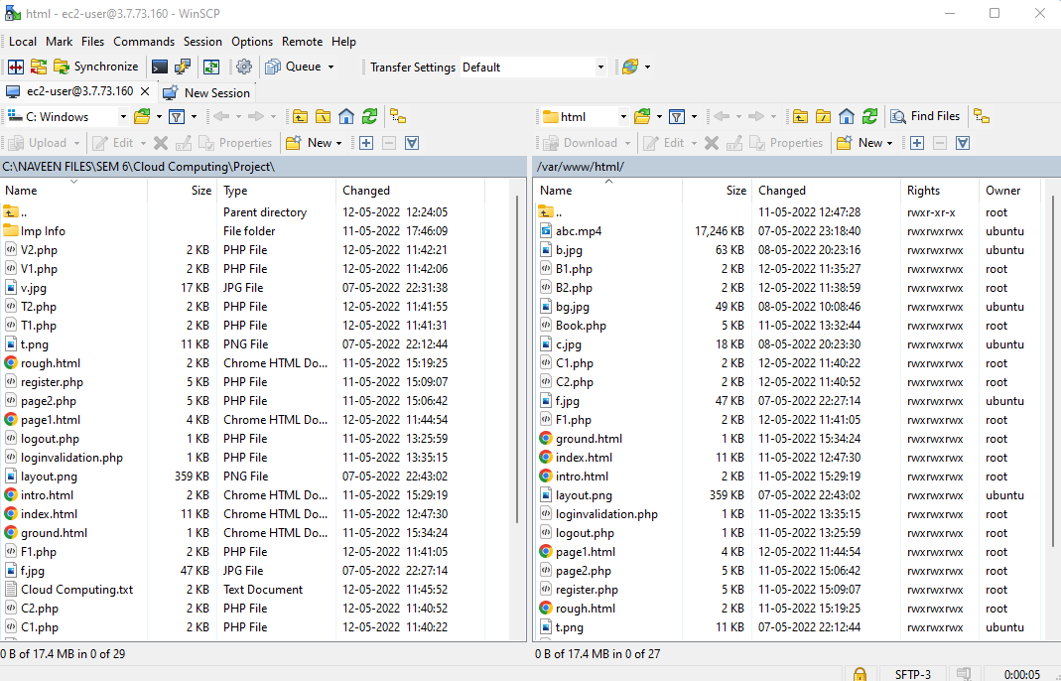

Slide 32
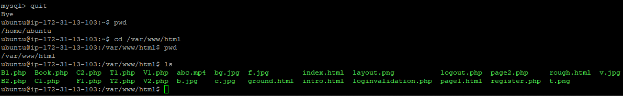
Viewing the List of files via PuTTY:

Slide 33
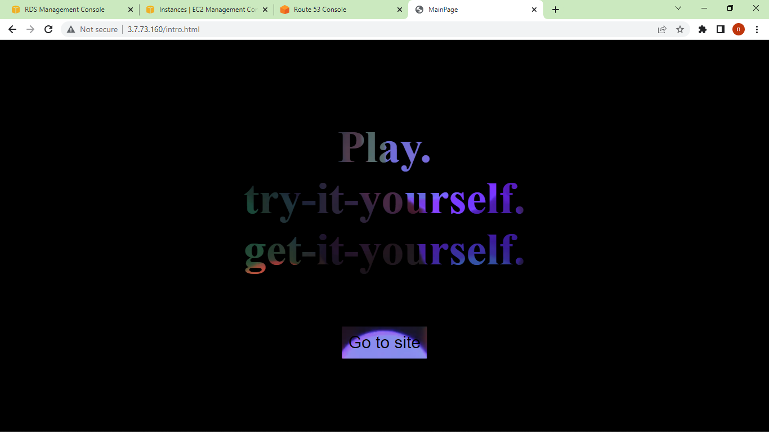
Checking if the web application is hosted or not:
We must go to <IP Address>/intro.html. Here IP Address of our EC2 instance is 3.7.73.160. So we must go to 3.7.73.160/intro.html

Slide 34
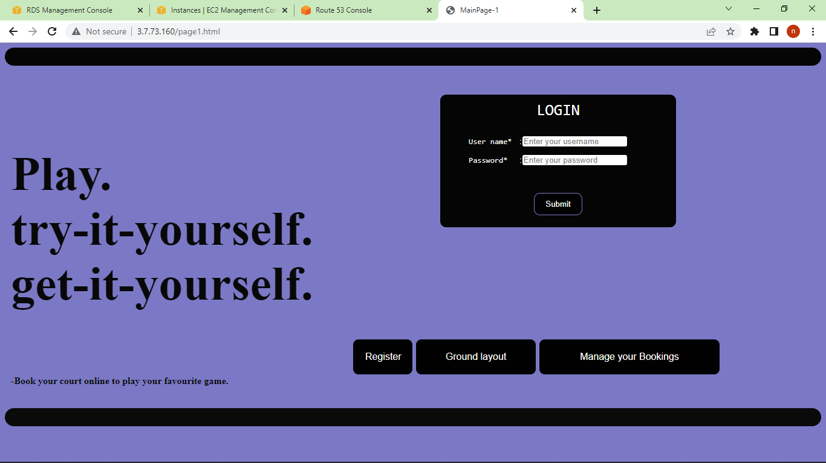

Slide 35
Amazon Route 53:
The web application is hosted and its working fine. But, remembering the IP address to access the web application is very difficult. That is why, we need to provide a domain name for it.
Route 53 can be used to for this purpose.
But, getting domain name from Route 53 costs us.
“freenom.com” provides domain names for free.

Slide 36
Steps Involved:
Go to freenom.com and get a domain name for free.
Then, go to amazon route 53 and click create hosted zone
Then, type the domain name acquired from freenom and click create.
Now, go to the created hosted zones and note down the nameserver values.
Then, go to freenom -> Services -> My Domain -> Manage Domain -> Management Tools -> Nameservers and enter the noted values.
Then go back to Route 53 and click create record and enter the public IPv4 address of our EC2 instance in value field and click create.
click create record agin and enter www in Record name field and enter the public IPv4 address of our EC2 instance in value field and click create.
Now, we can use domain name.

Slide 37
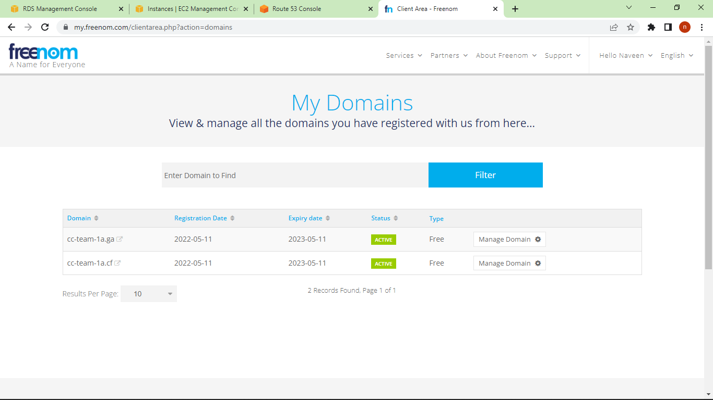

Slide 38
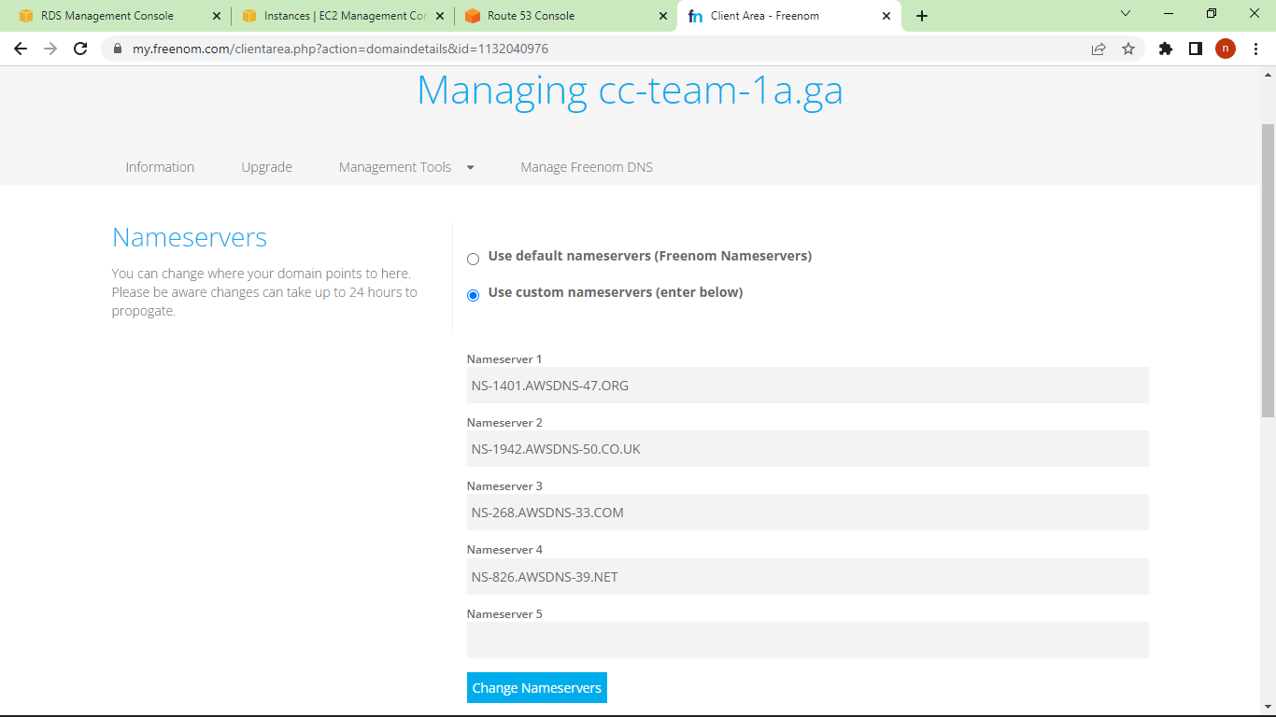

Slide 39
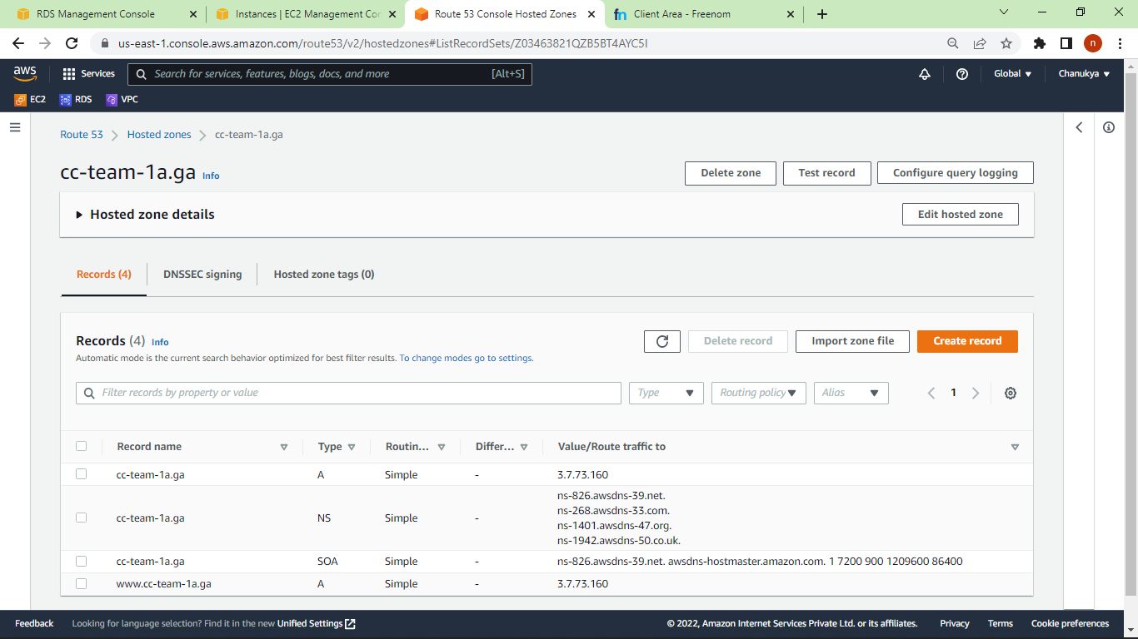

Slide 40
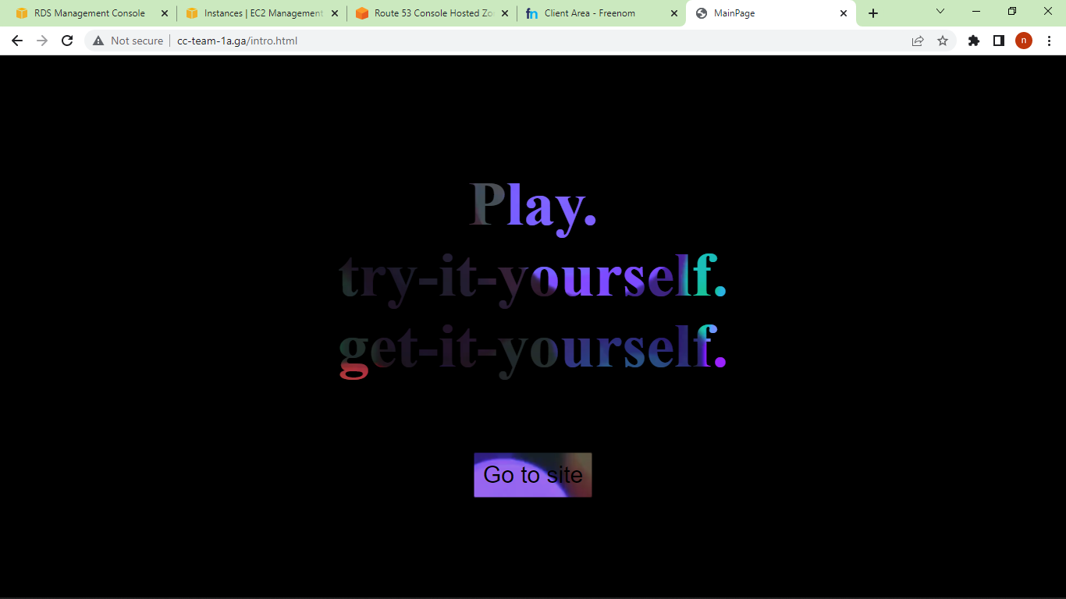
Testing the hosted Web Application:

Slide 41
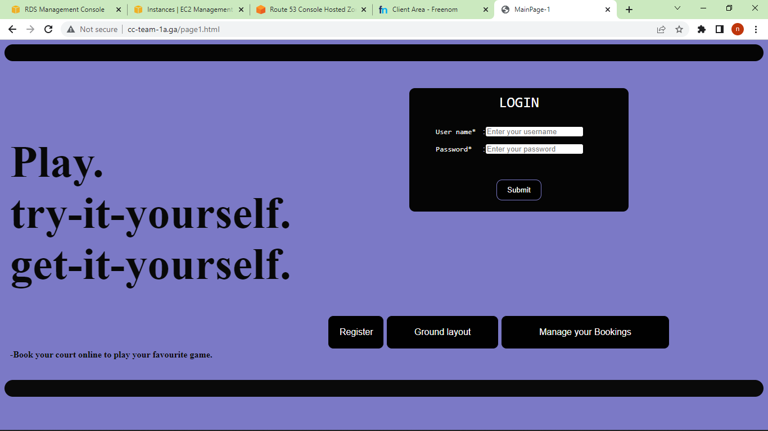

Slide 42
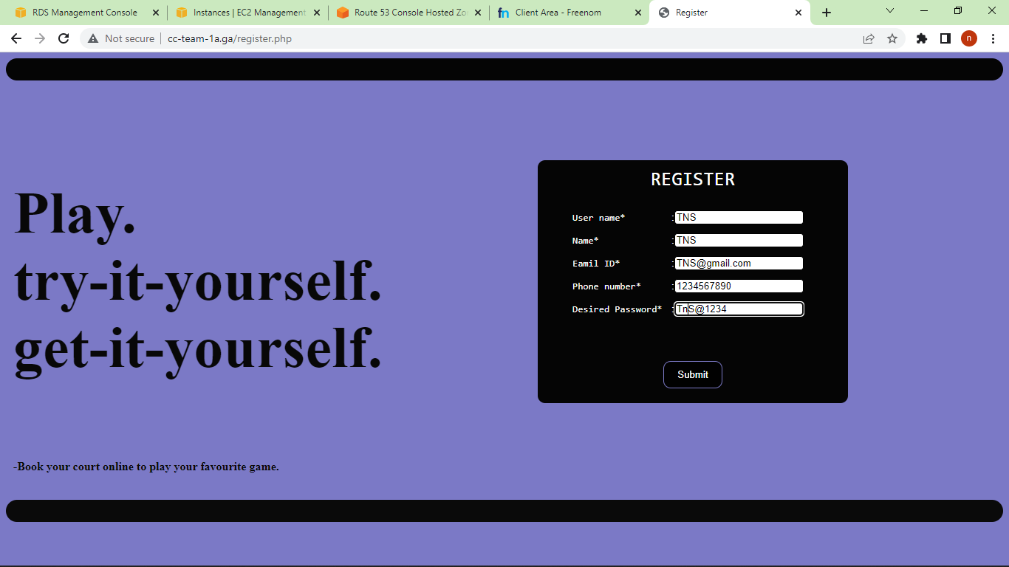
Registering:

Slide 43
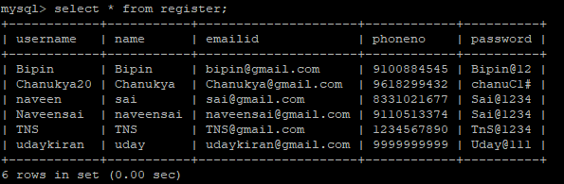
Checking if the values are stored in database or not:

Slide 44

Logging in

Slide 45
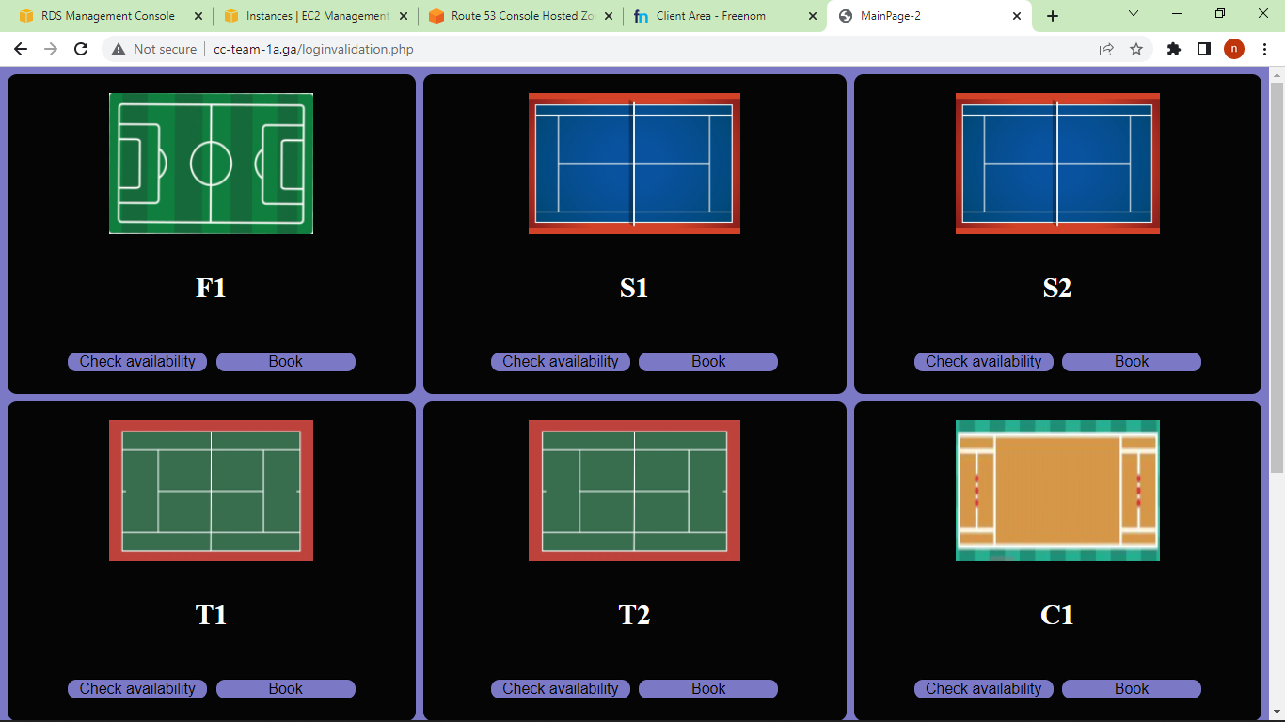

Slide 46
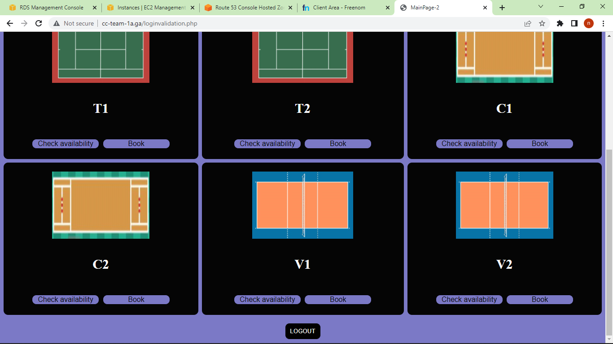

Slide 47
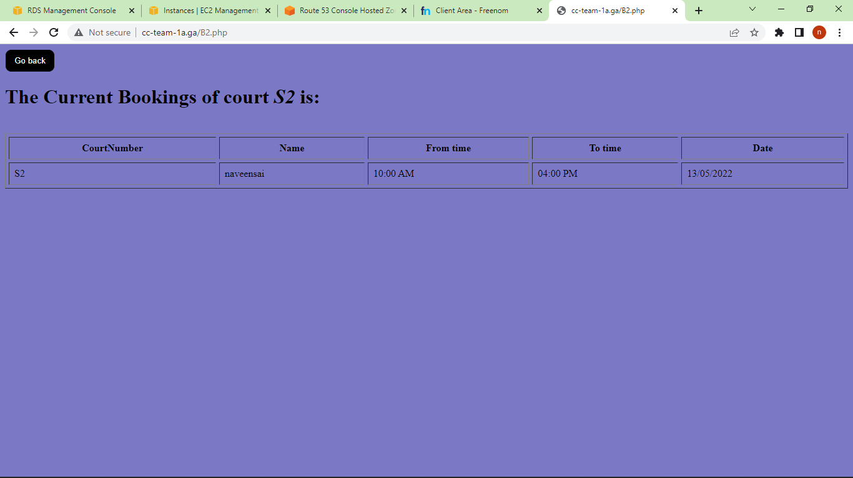
Checking Availability for S2:

Slide 48

Checking the Availability of S1:

Slide 49
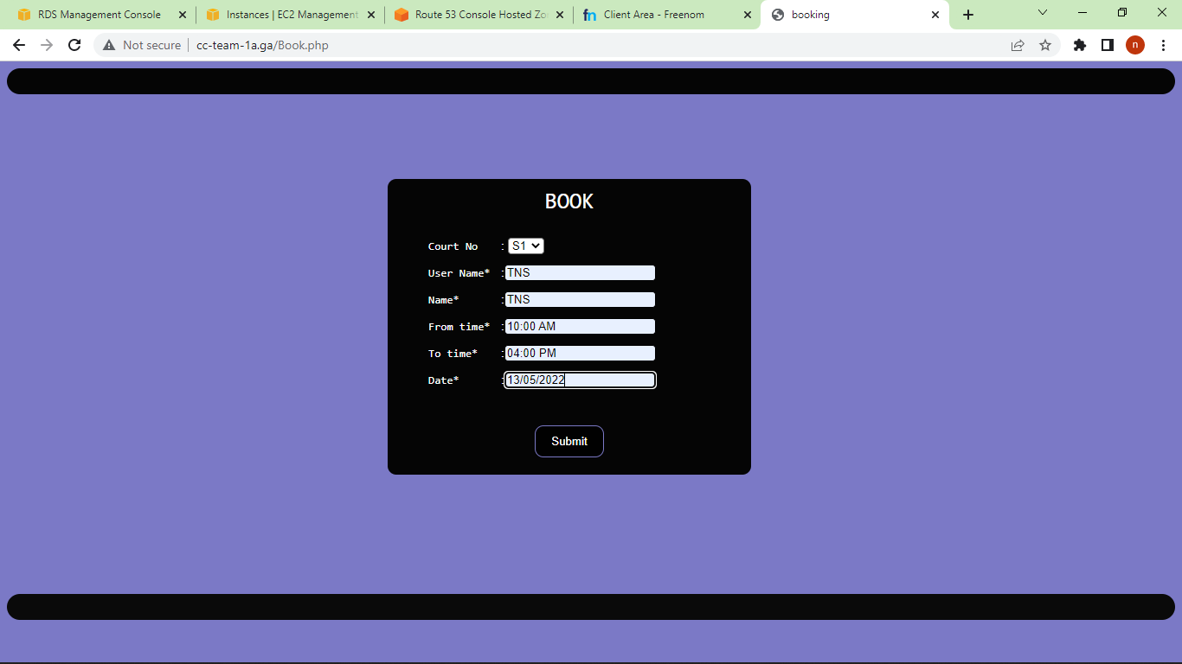
Booking Court S1:

Slide 50
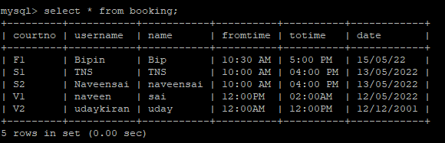
Checking if the values are stored in database or not:

Slide 51
Demonstration Video Links:
Part-1: https://drive.google.com/file/d/1Y3BoOK2LIq9fbrOw_j3o1ucFPX8w3lmI/view?usp=sharing
Part-2: https://drive.google.com/file/d/18VHBJ3FKjfVwJQbciP7KGpXN72_CODJE/view?usp=sharing
Part-3:
https://drive.google.com/file/d/1DJXnEHkGX1uxU5M8jMi0DEHFP1nohcX6/view?usp=sharing
Part-4:
https://drive.google.com/file/d/1HEkGf7XTVh0r-6cS7q4Y6u_mv8p0AXdz/view?usp=sharing

Slide 52
Conclusion:
We were able to host our Court Booking web application using Amazon EC2, RDS and Route 53 and were able to access the application from an external PC connected to Internet.

